Slide 1



Presentation on
Insurance Management
System
Date:
08-08-2022
Presented By:
Sivanayan
Nachiket
Manjunath
Sujitkumar

Slide 2




Introduction
The system can manage and allow users to sign up for a variety of insurance plans falling under two categories, health and home insurance.
The Insurance system is for making easier to manage policy holder details, policy details. So this will be developed for managing the insurance management system.

Slide 3
Approach
Front-end
Angular
Back-end
Spring boot
Database
MySQL

Slide 4
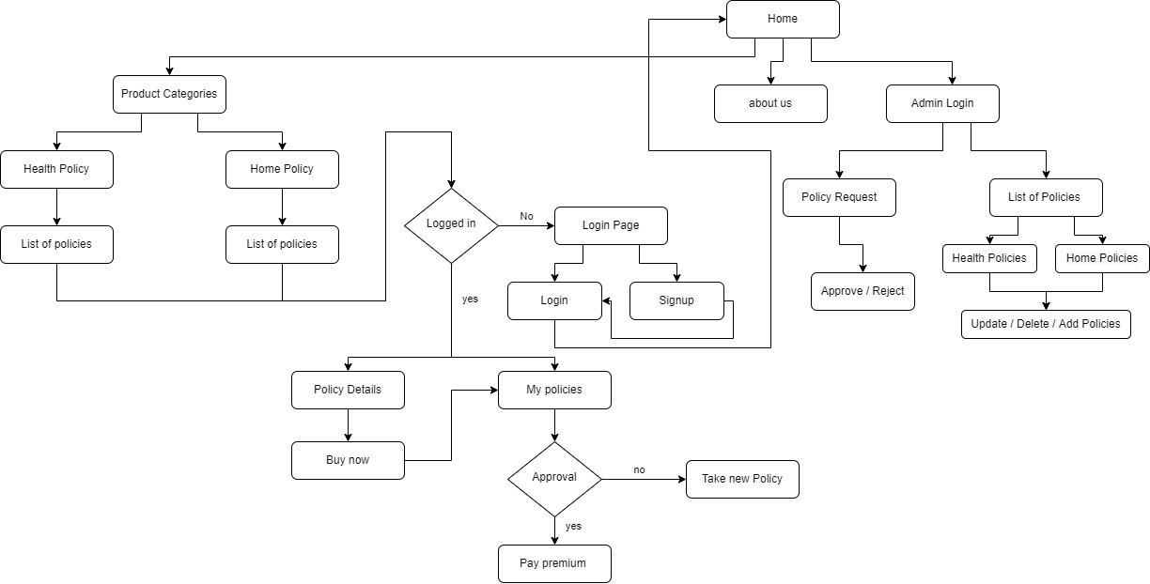
Flow

Slide 5
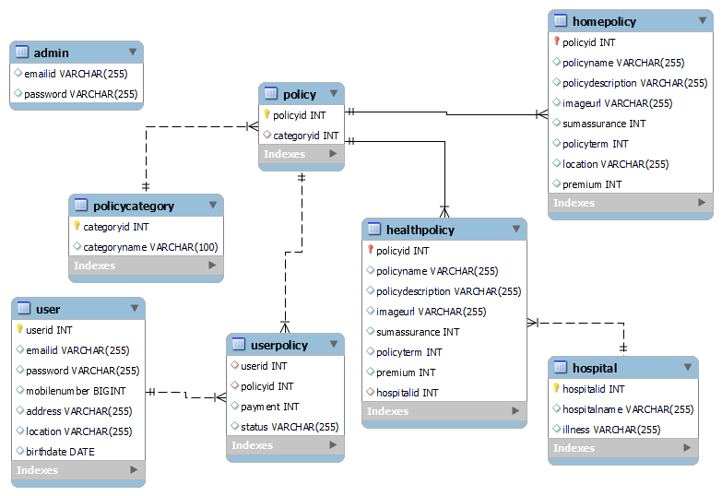
Database Tables

Slide 6
Basic Operations
User
View list of Policy
Login / Signup
Buy Policy / View user Policies
Admin
View list of Policy holders and policies
Approve / Reject user Policies
Add / Update / Delete Policies

Slide 7
Statistics
Angular
12 Components
Spring Boot
8 Entity classes
MySQL
8 Tables

Slide 8
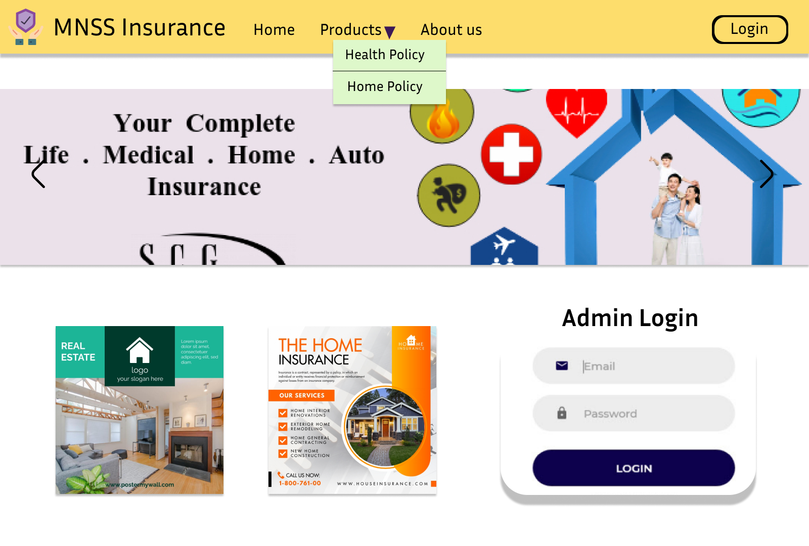
Demo

Slide 9
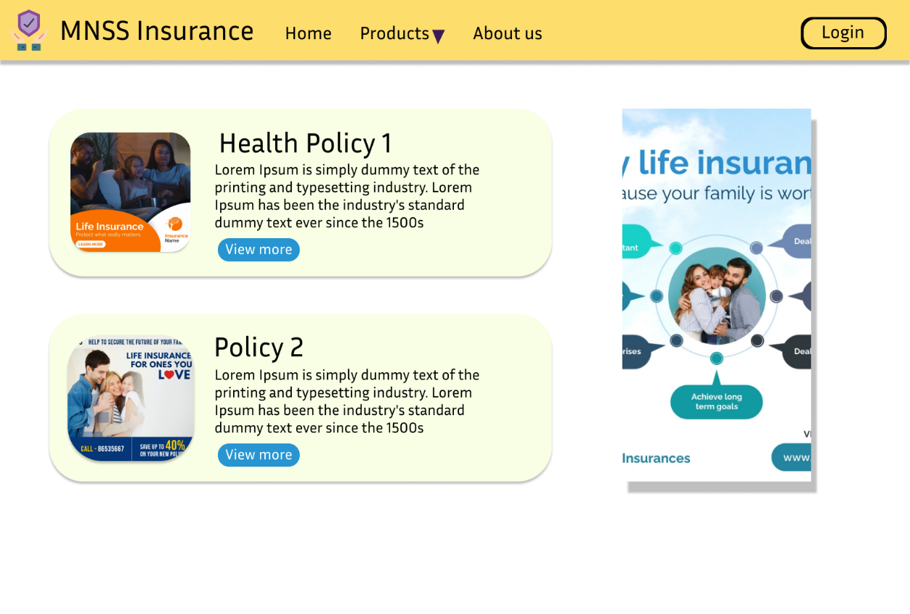
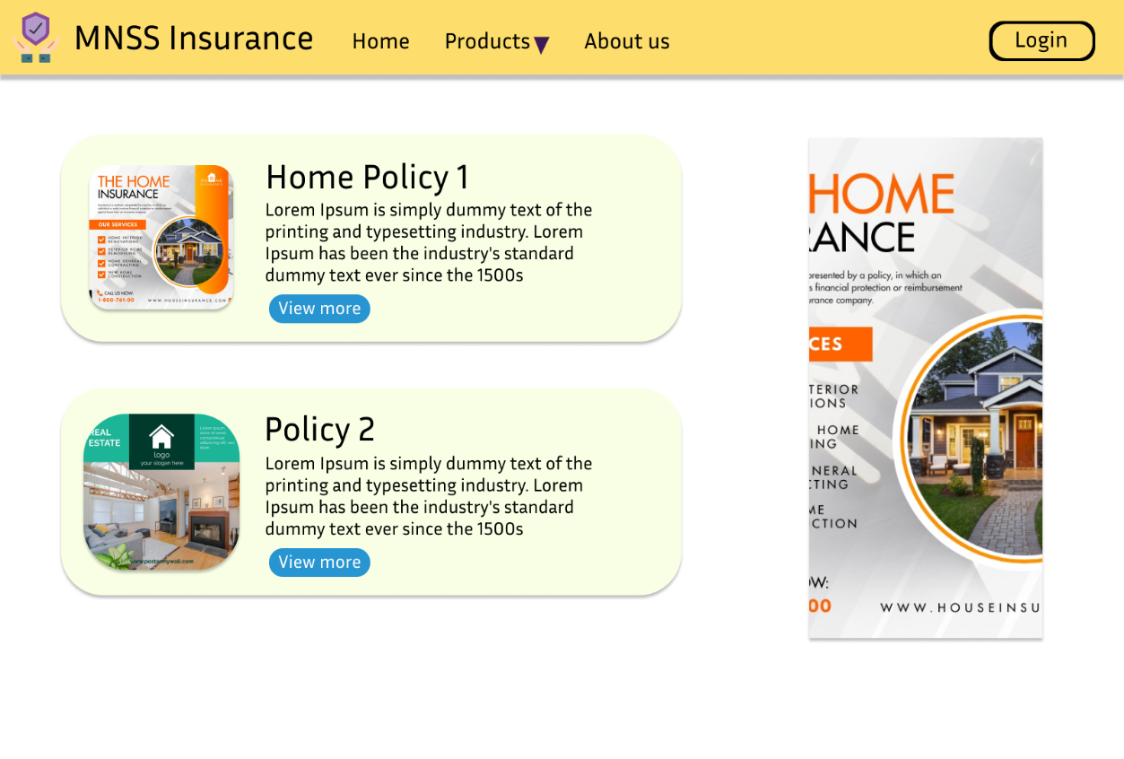
Demo
Health & Home Policy Page

Slide 10
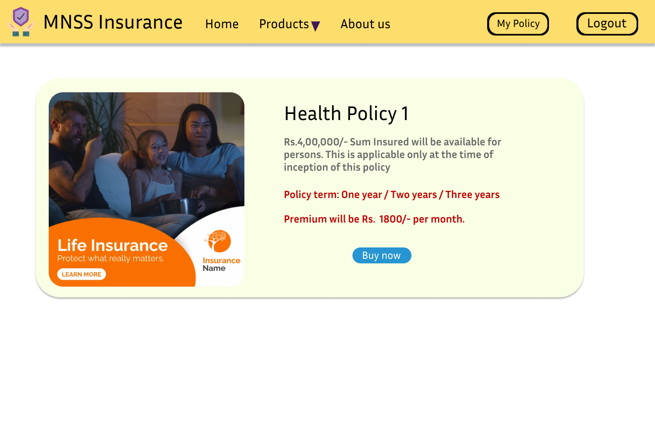
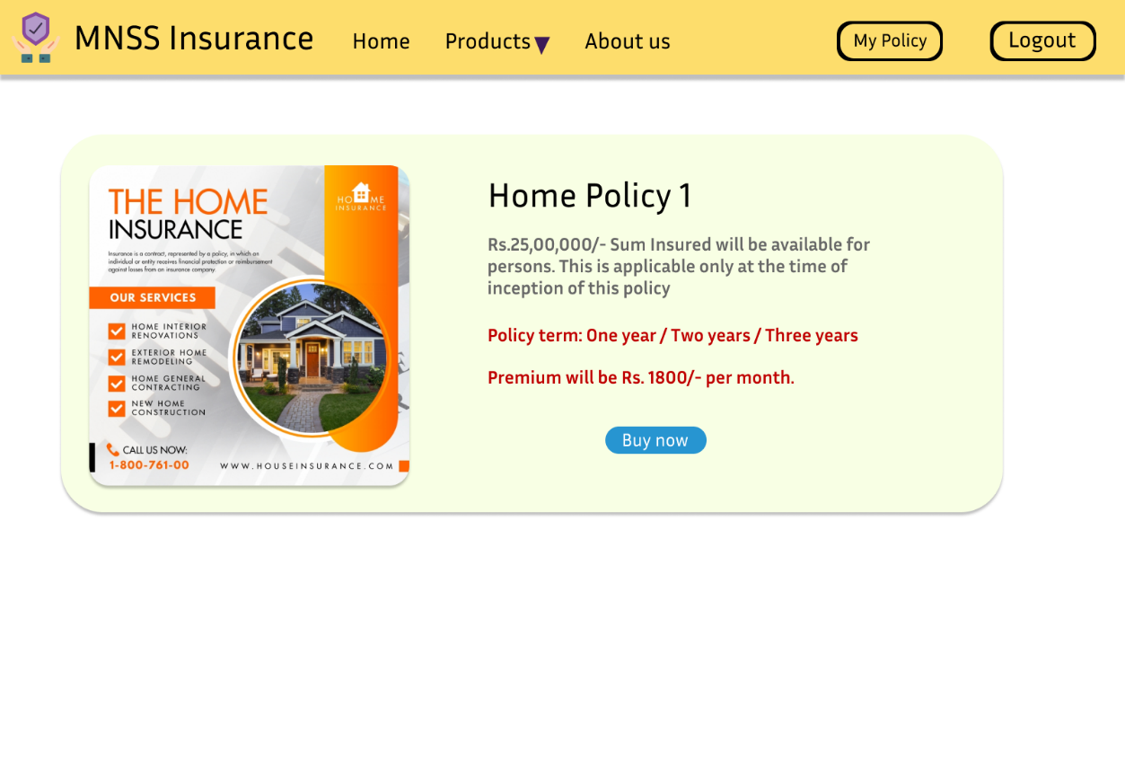
Demo
Health & Home Policy Details Page

Slide 11
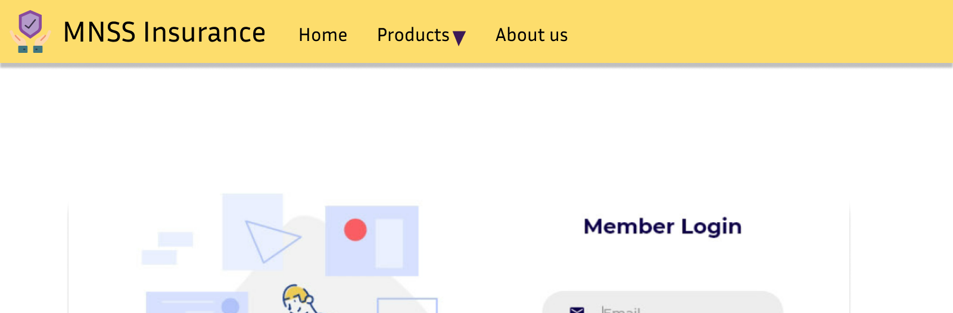
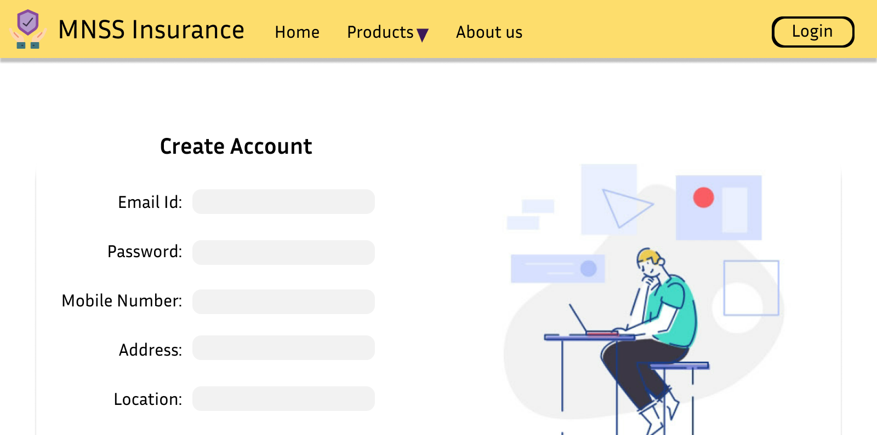
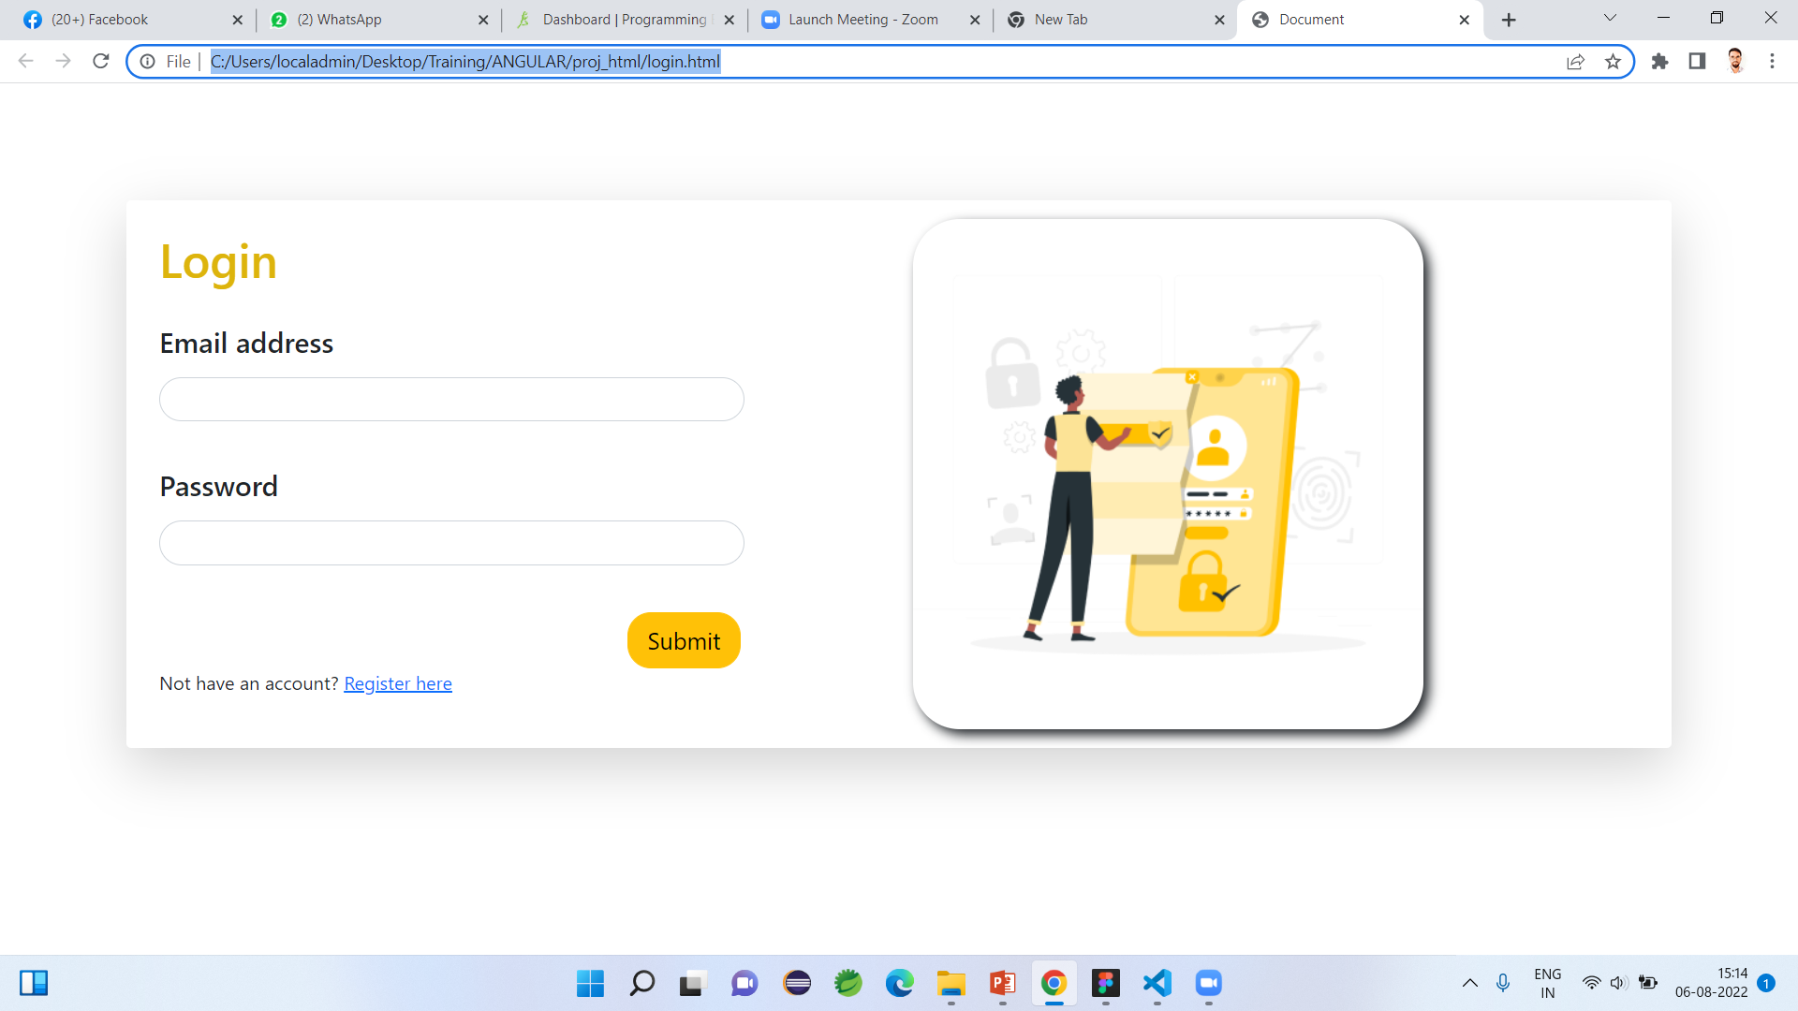
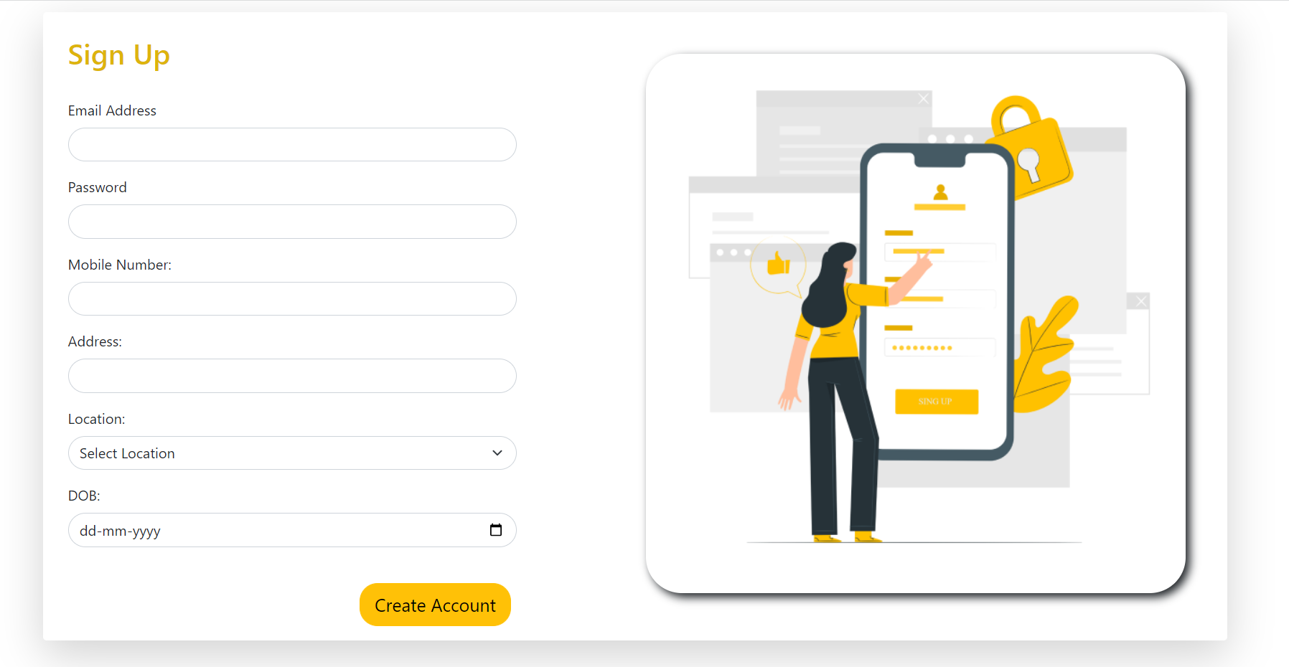
Demo
User Login & Register page

Slide 12
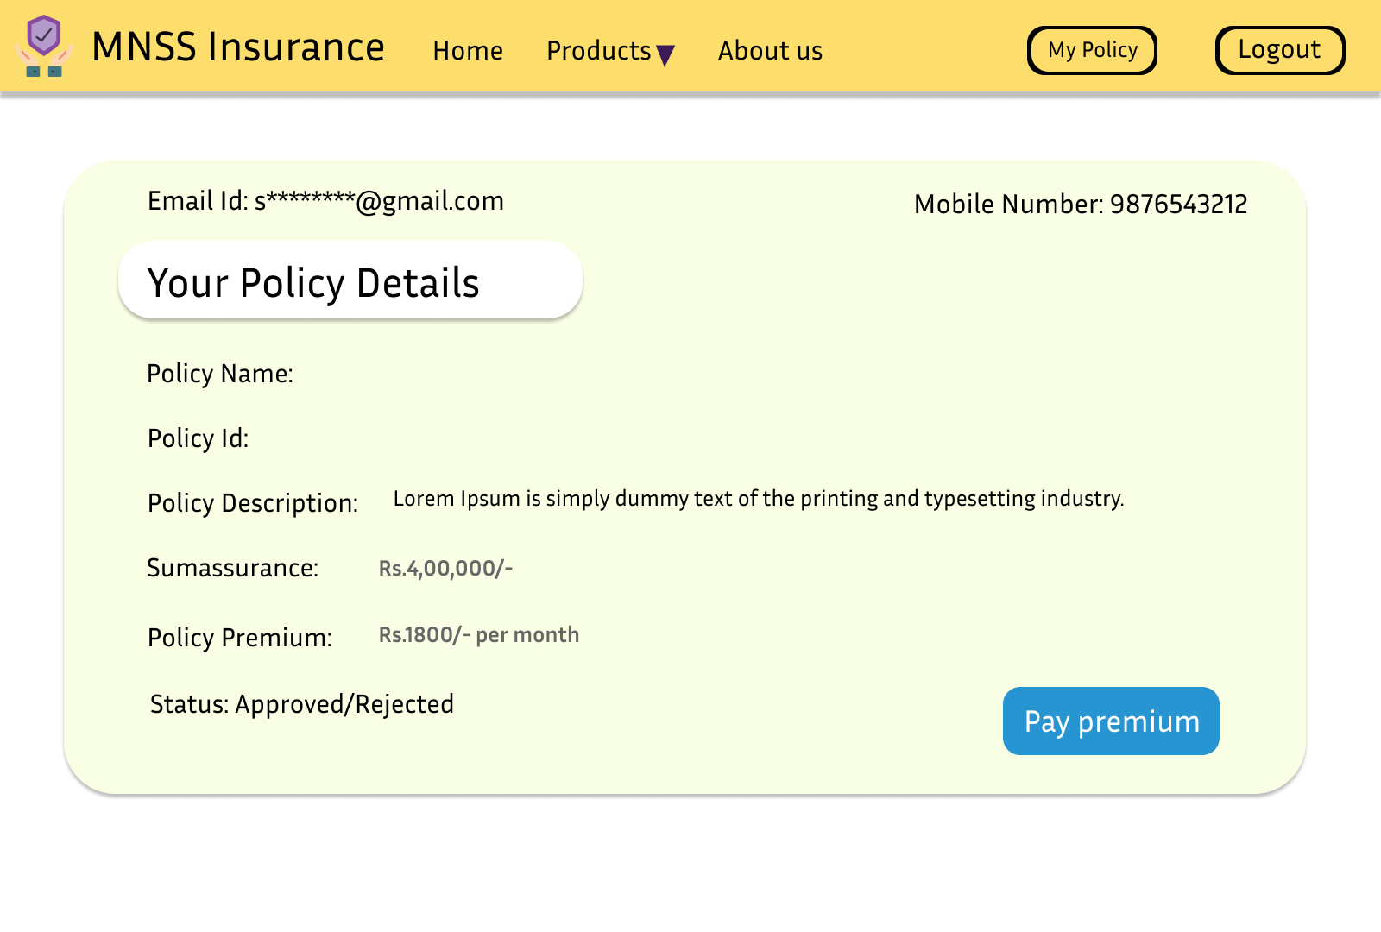
Demo
User policies

Slide 13
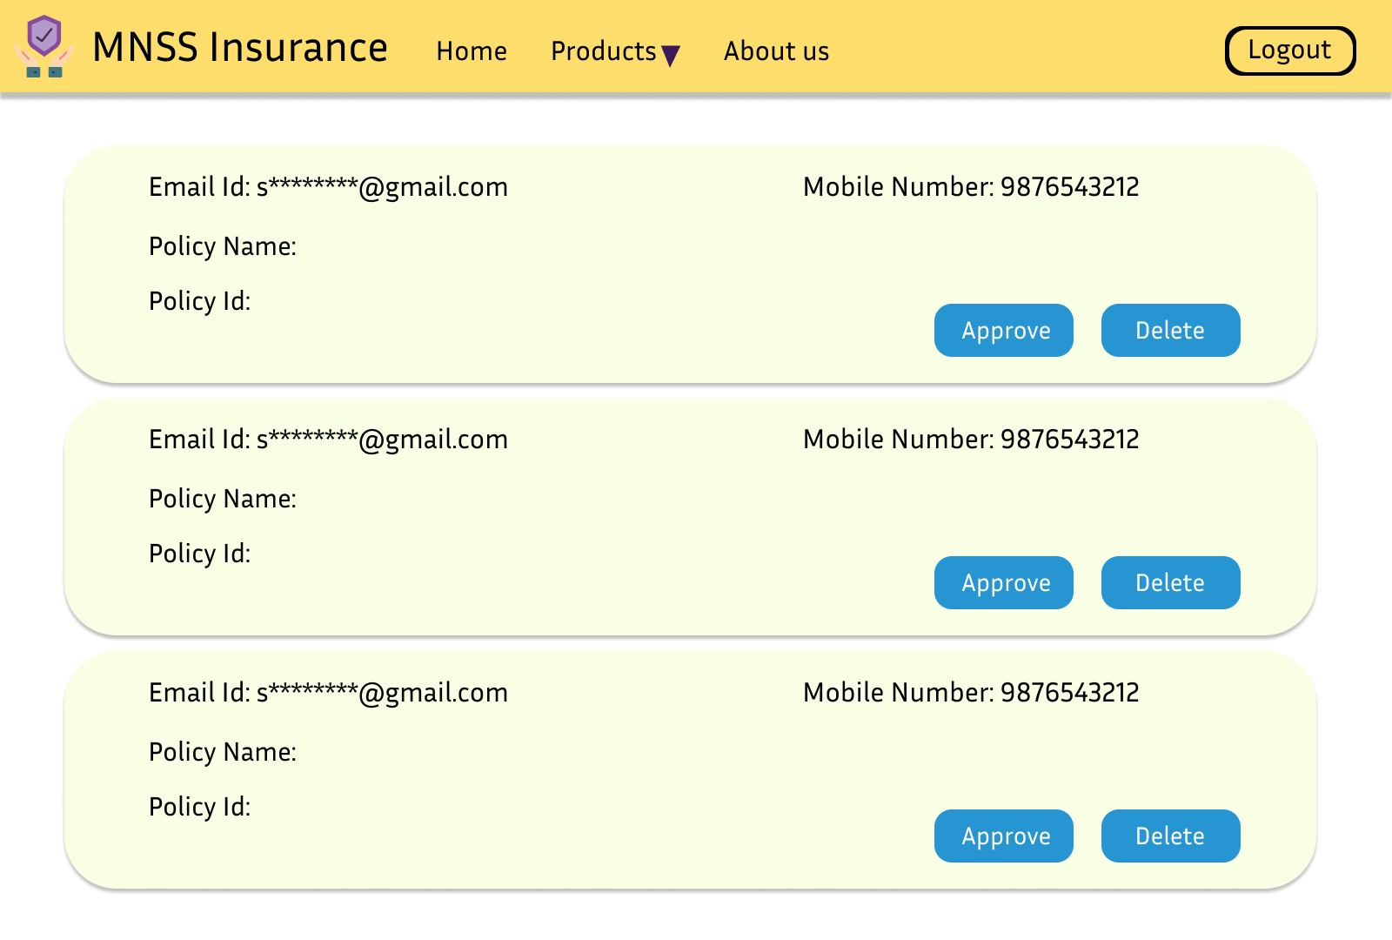
Demo
User policies for Admin
Policy Listing
Policy Listing

Slide 14


